Slide 1

Capstone Project 3
Supervised ML - classiﬁcation
Cardiovascular risk prediction
SHIVAM PANDEY

Slide 2
Contents
Problem Statement
Data Summary
Data wrangling
Exploratory Data Analysis
Data Pre-Processing
Feature Manipulation & Selection
Model Implementation
Conclusion

Slide 3
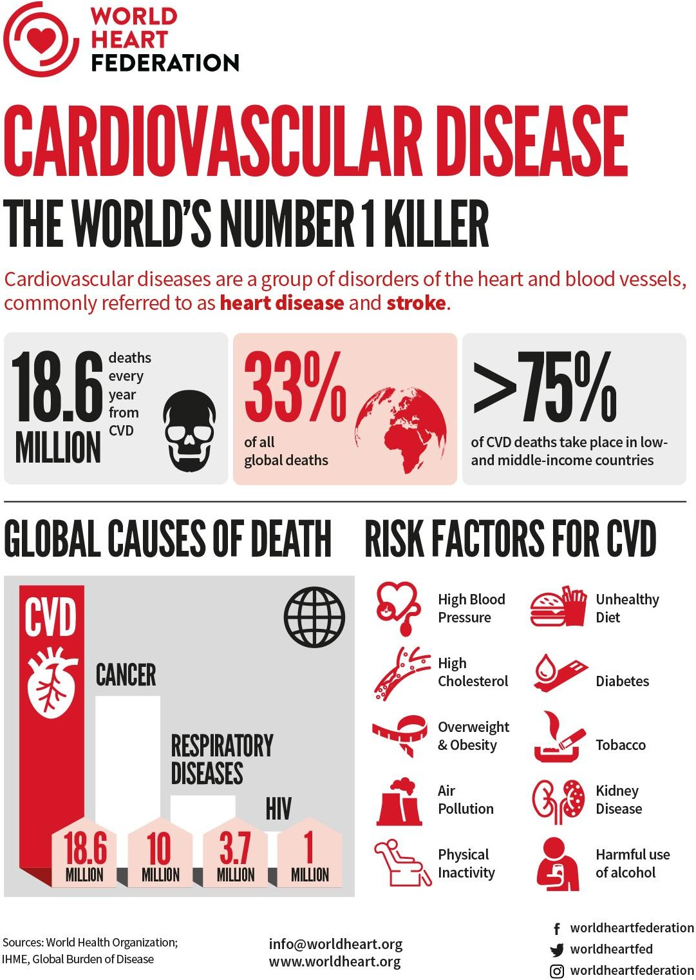
Problem statement:
Coronary heart diseases (CHDs) are the leading cause of death globally, taking an estimated 18.6 million lives each year, which accounts for 33% of all the global deaths.
Therefore, It is important to detect cardiovascular diseases as early as possible so that management with counselling and medicines can begin.
Our main aim here is to predict if a patient has a ten year risk of future coronary heart diseases based on a set of metrics.

Slide 4
Understanding the data:
To increase the efficiency of our analysis we will first have to understand the data and also check if there are some corruptions in the data and if any found we will try to treat it.
The dataset contains information on 3,390 individuals with 16 predictor variables and 1 target variable.There are demographic, behavioral, and medical risk factors.
Each attribute(column) is a potential risk factor. These attributes include demographic, behavioral, and medical risk factors.
Now we will look at what each column means.

Slide 5
The columns involved:
**Id**: A unique identifier for each individual in the dataset.
**Age**: The individual's age in years.
**Education**: The individual's level of education or highest educational attainment, typically encoded as a categorical variable (e.g., less than high school, high school or equivalent, some college or vocational school, associate's degree, bachelor's degree, graduate degree).
**Sex**: The individual's biological sex, typically encoded as a binary variable (0 for female, 1 for male).
**Is_smoking**: A binary variable indicating whether the individual is a current smoker (1) or not (0).
**CigsPerDay**: The average number of cigarettes smoked per day by individuals who reported smoking.
**BPMeds**: A binary variable indicating whether the individual is taking blood pressure medication (1) or not (0).
**PrevalentStroke**: A binary variable indicating whether the individual has a history of stroke (1) or not (0).

Slide 6
Contd.:
**PrevalentHyp**: A binary variable indicating whether the individual has hypertension (1) or not (0).
**Diabetes**: A binary variable indicating whether the individual has diabetes (1) or not (0).
**TotChol**: The individual's total cholesterol level, measured in milligrams per deciliter (mg/dL).
**SysBP**: The individual's systolic blood pressure, measured in millimeters of mercury (mmHg).
**DiaBP**: The individual's diastolic blood pressure, measured in mmHg.
**BMI**: The individual's body mass index, a calculated value based on the individual's height and weight, often used as an indicator of body fatness and overall health.
**HeartRate**: The individual's resting heart rate, measured in beats per minute (bpm).
**Glucose**: The individual's fasting blood glucose level, measured in mg/dL.
**TenYearCHD**: Is a binary variable used to indicate whether an individual is at high risk or low risk for developing coronary heart disease (CHD) within the next 10 years.

Slide 7



Initial preparation:
In this section I’ve loaded in the dependencies, like pandas, seaborn, and many more from the scikit learn library.
The next step was to mount the drive where the data was stored.
After mounting the drive I used the pandas.read_csv() function to read the data given to us in csv format.

Slide 8
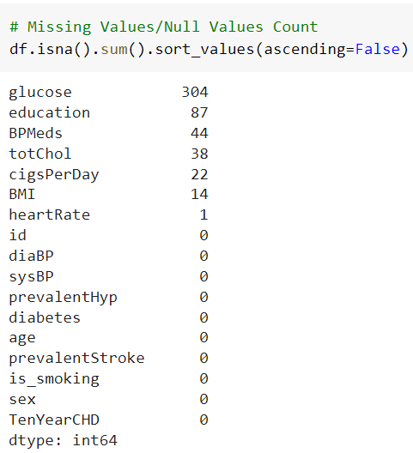
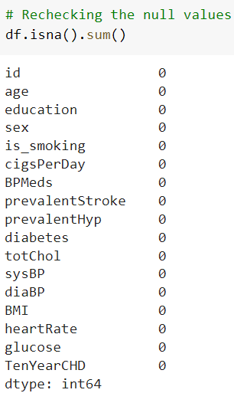
Missing Values:
The First part glucose, totchol, heartRate and BMI filled with median.
The Second part education and BPMeds filled with mode
The Third part cigsPerDay filled with mean.

Slide 9
Exploratory Data
Analysis

Slide 10
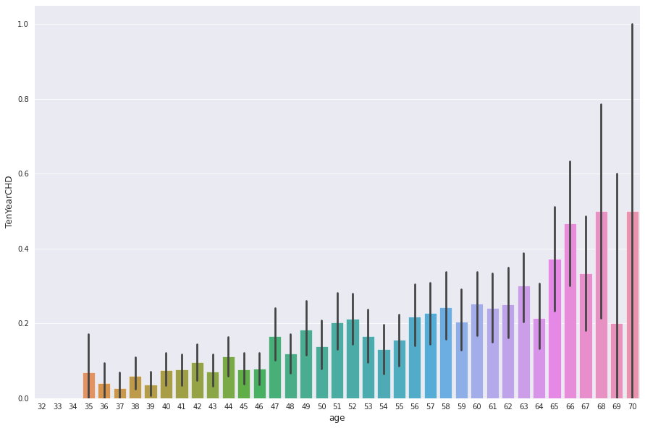
Exploratory Data Analysis:
In this step I have done exploratory data analysis on the data to see if I can find some valuable insights that can be directly applied to reduce the chances of having a positive CHD risk factor.
I have plotted each attribute against the target variable to see how it affects the target variable.

Slide 11
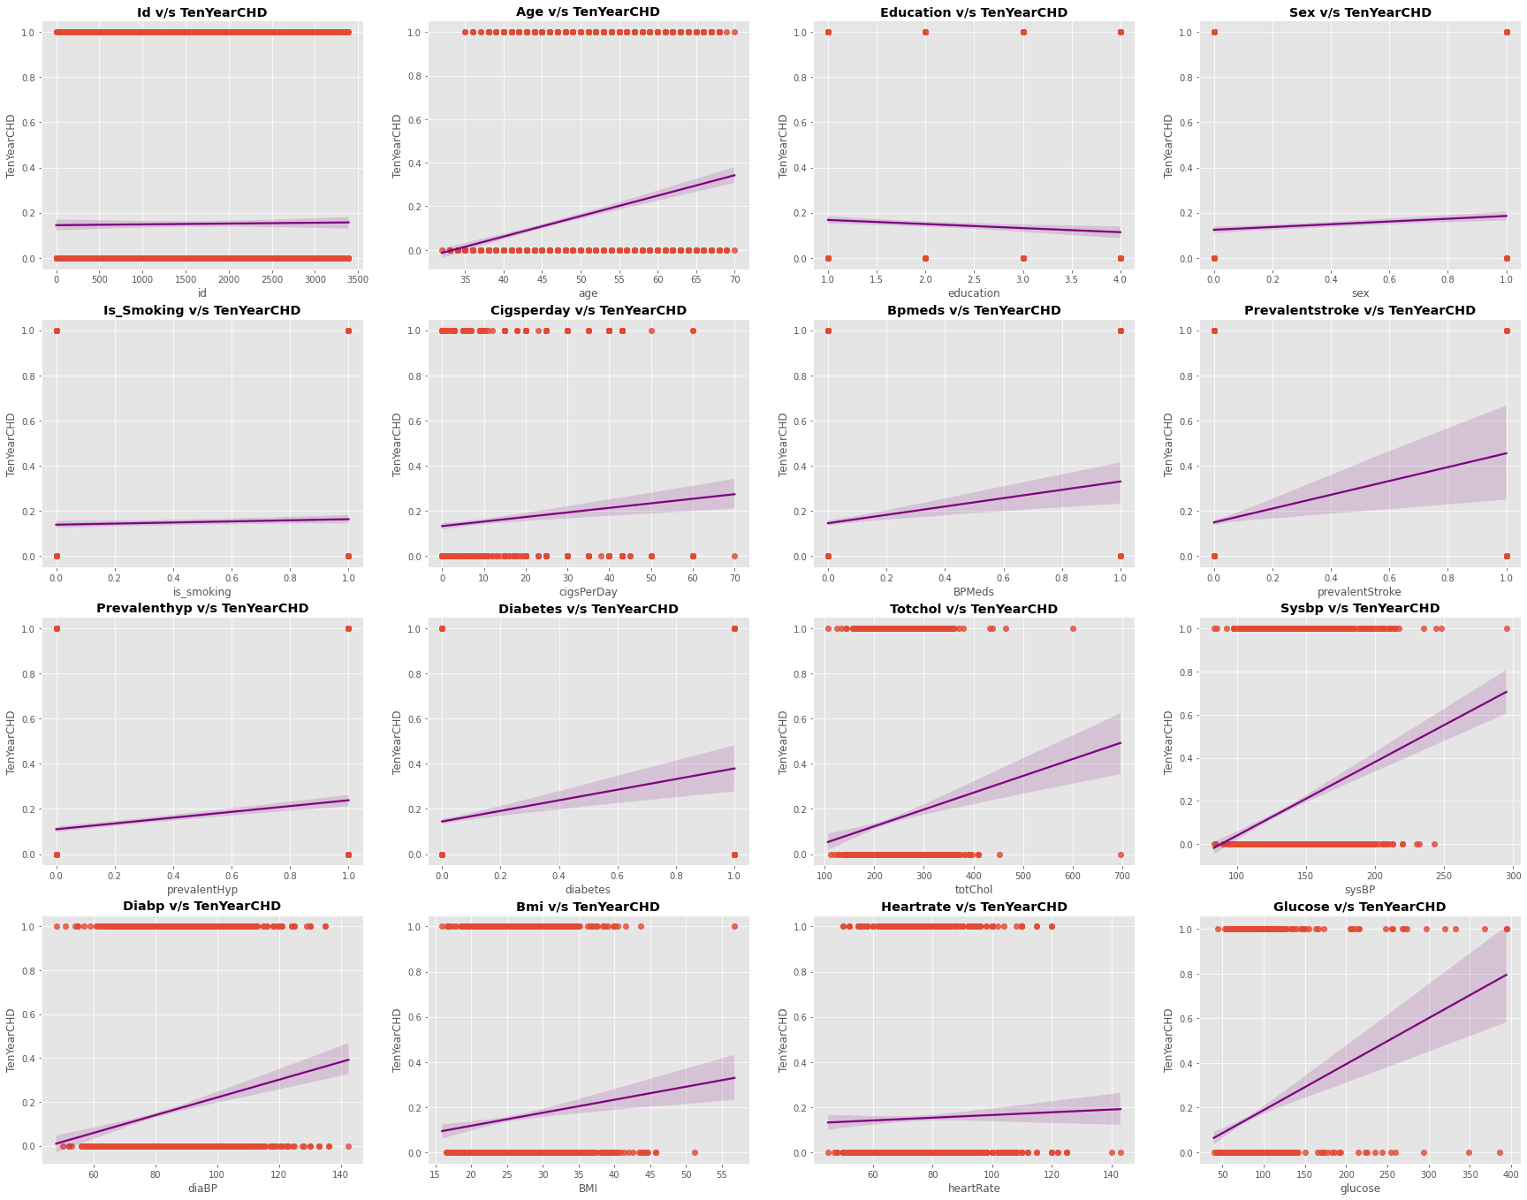
Exploratory Data Analysis:

Slide 12
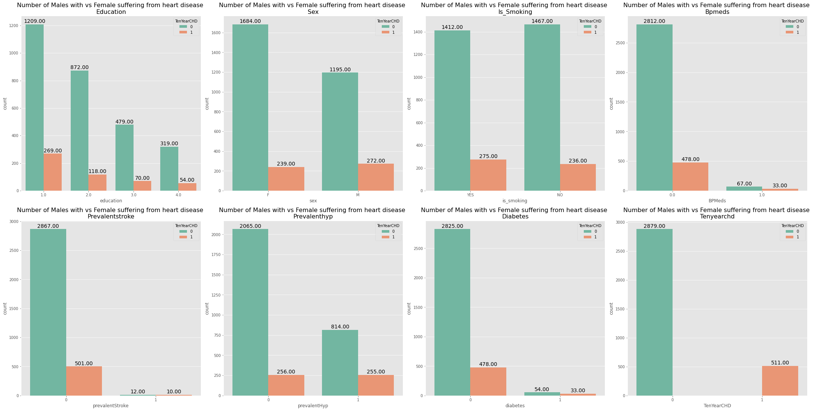
Exploratory Data Analysis:

Slide 13
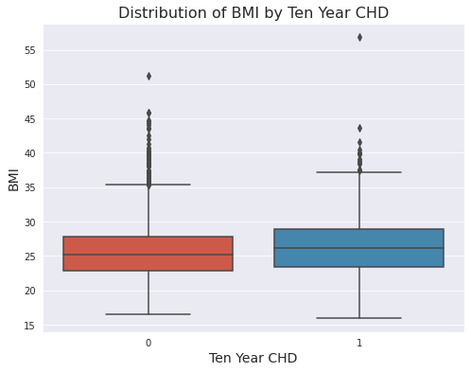
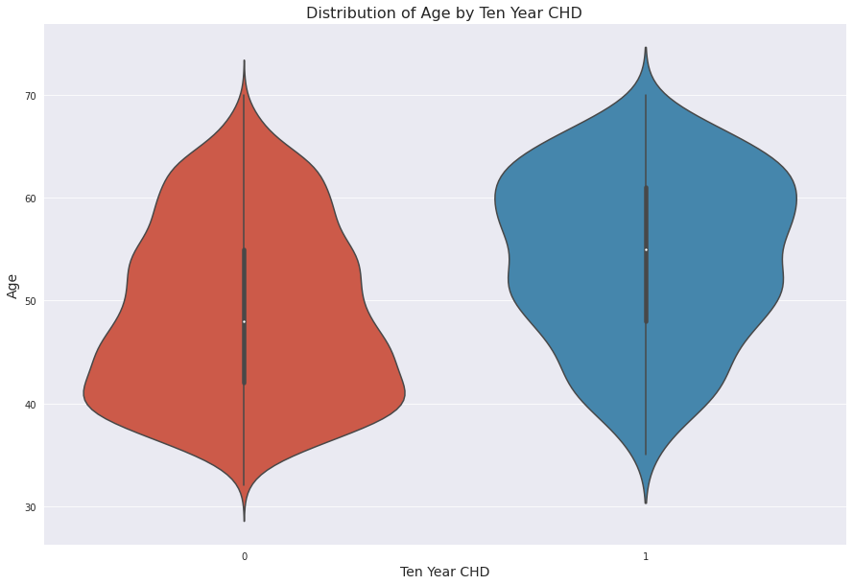
Exploratory Data Analysis:
Distribution Of Age by Ten Year Distribution Of BMI by Ten Year

Slide 14
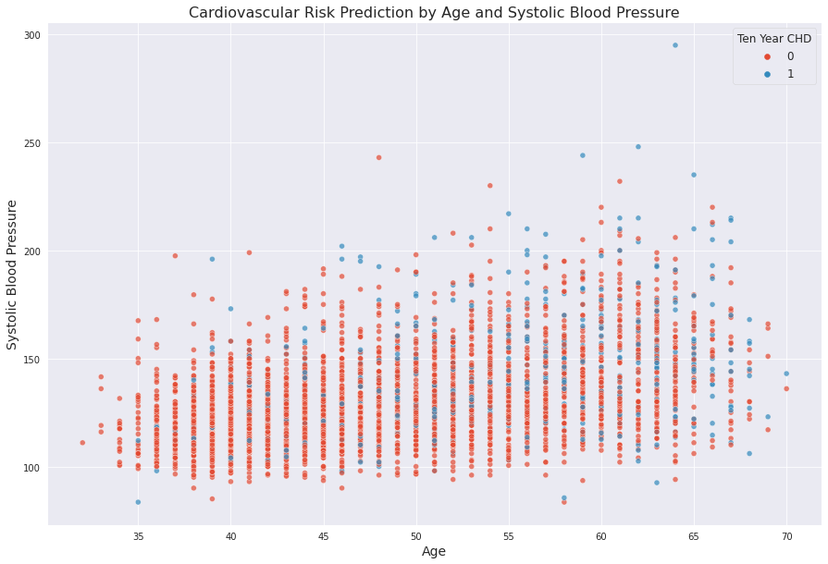
Exploratory Data Analysis:

Slide 15
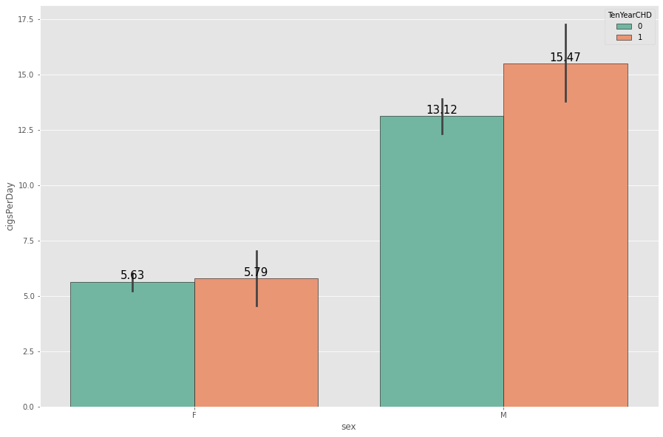
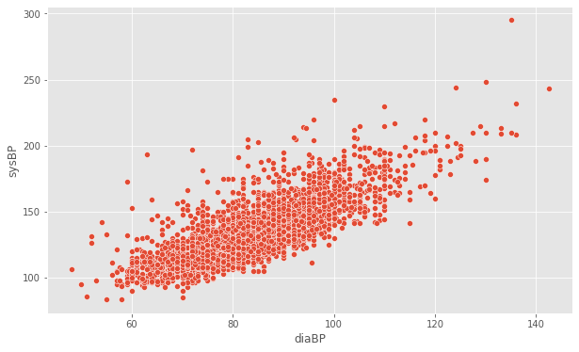
Exploratory Data Analysis:
Distribution Of Cigrates Per Day Over Sex Blood Pressure VS Diabetes

Slide 16
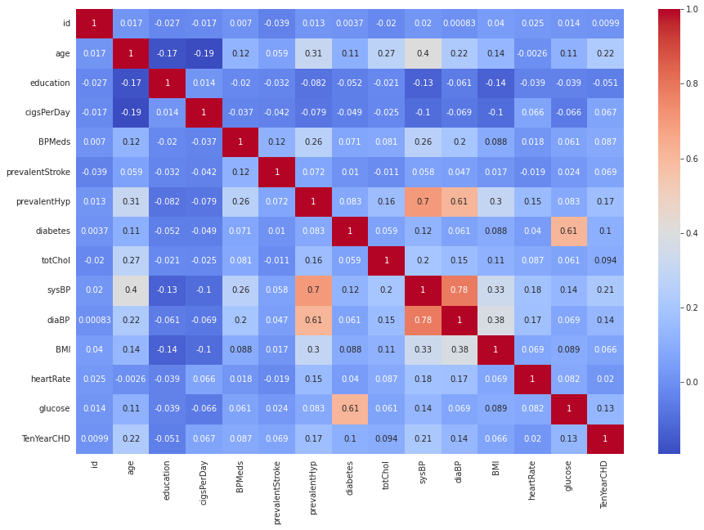
Exploratory Data Analysis:

Slide 17
Feature Engineering

Slide 18
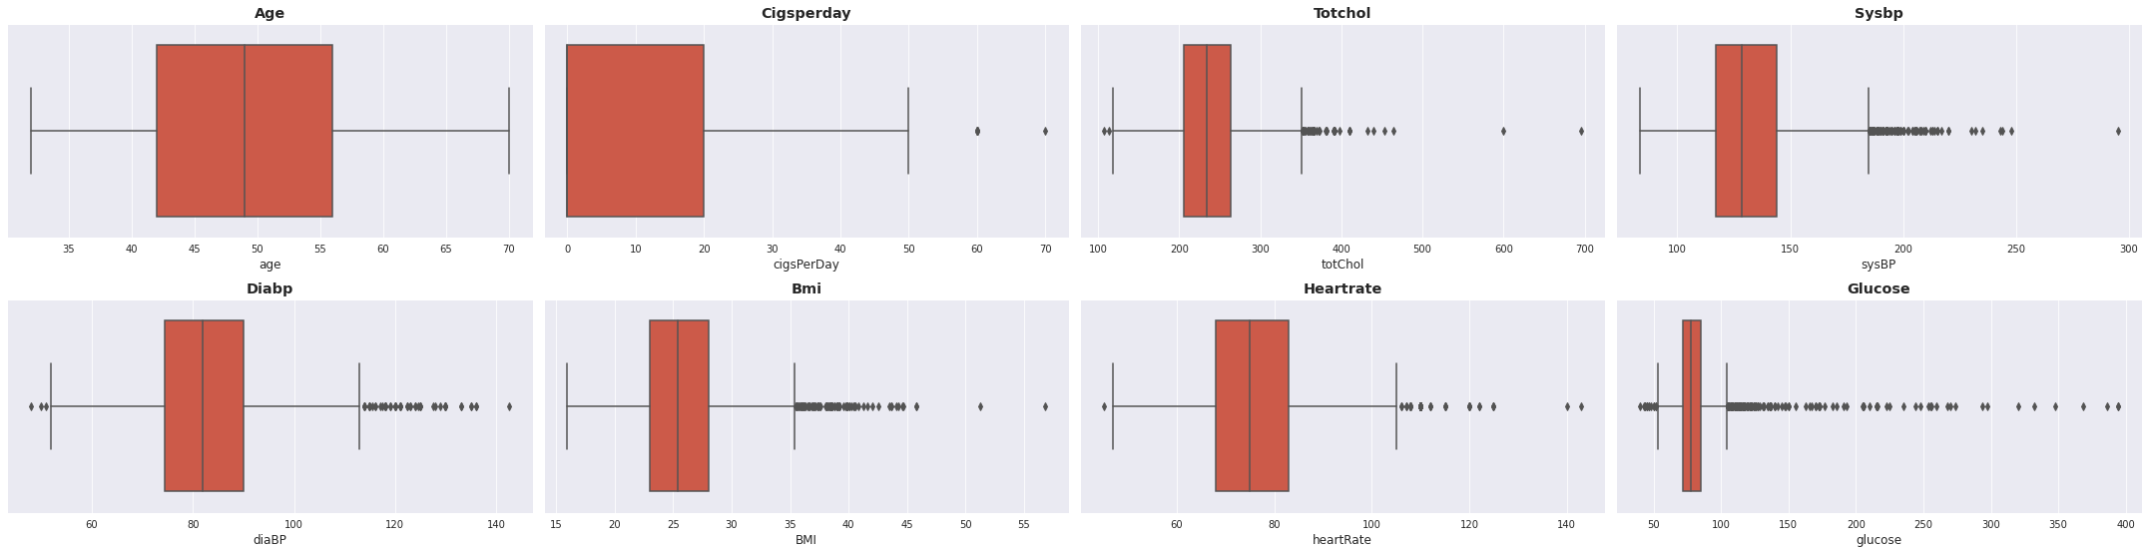
Outeliers Treatment
Removing Outliers: First of all we find the variables that may contain outliers, to detect this I’ve used the box plot offered by seaborn library.
Here we can see that many columns contain outliers, but they are all practically possible values.
Keeping in mind this idea of practicality, I will allow these outliers to stay in our data because they will impact our predictions.

Slide 19
Feature Encoding: Machine learning models can only work with numerical values and therefore we have to turn the categorical columns to numeric columns, and this is achieved by Label encoding. In our dataset we have two such categorical columns, sex and is_smoking which we have to convert to numeric columns.
Extracted new feature glucose_diabetes with the help of Glucose and Diabetes.
Extracted another new feature pulse_pressure with the help of sysBand and diaBp.

Slide 20
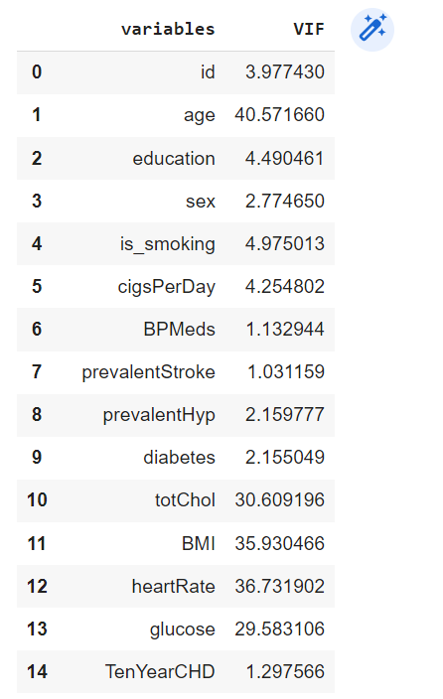
Multicollinearity

Slide 21
Model
Formulation

Slide 22
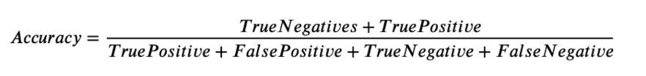
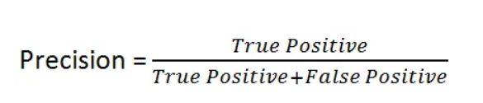
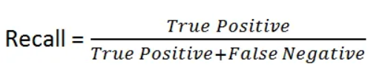
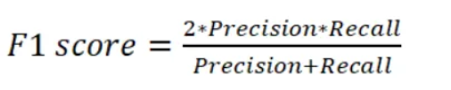
Important Matrices
Sr. No. | Functions | Formulae
01 | Accuracy
02 | Preciscion
03 | Recall
04 | F1-Score

Slide 23
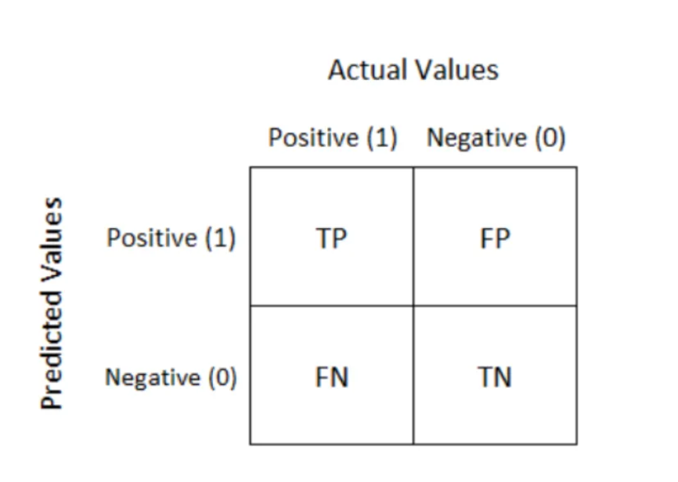
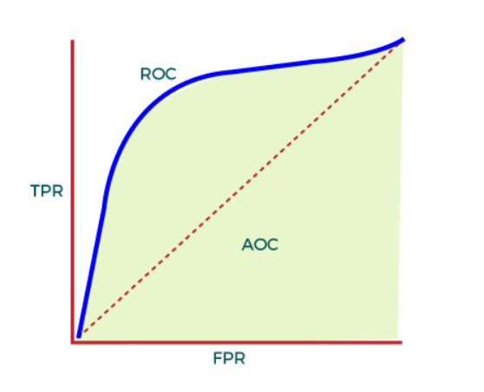
Important Matrices
Confusion Matrix ROC Curve

Slide 24
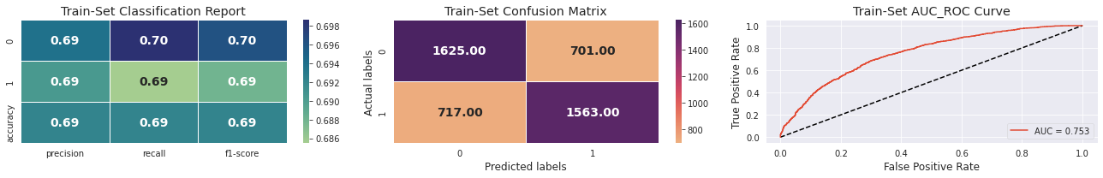
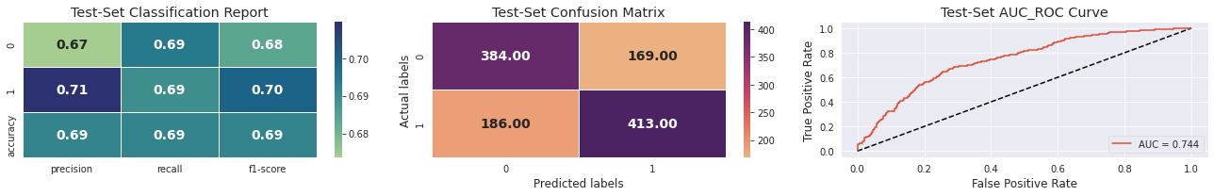
1. Logistic regression

Slide 25
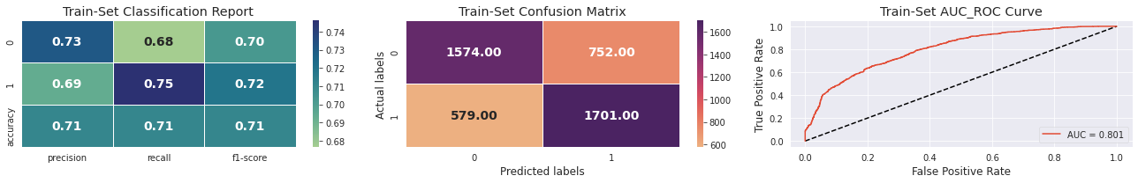
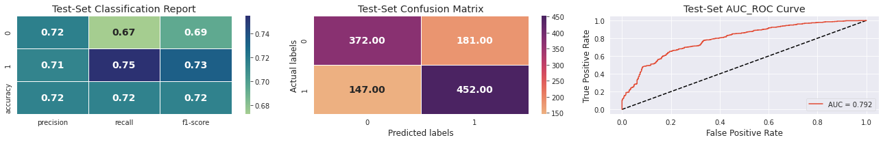
2. Random Forest

Slide 26
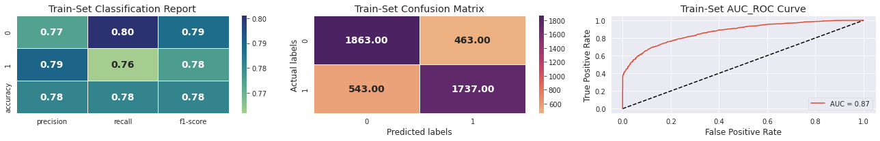
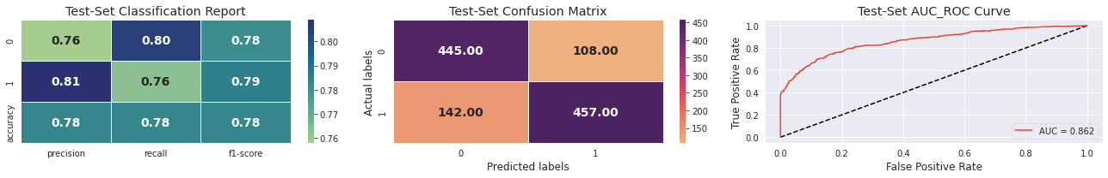
3.Xtreme-Boost(XGBoost)

Slide 27
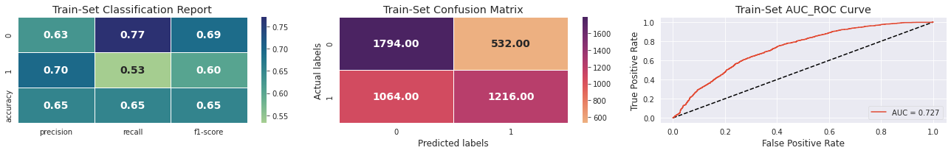
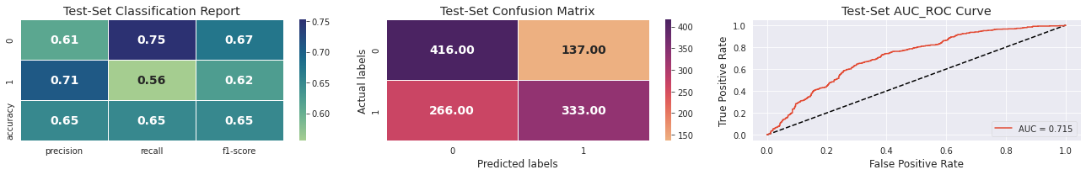
4. Naive Bayes

Slide 28
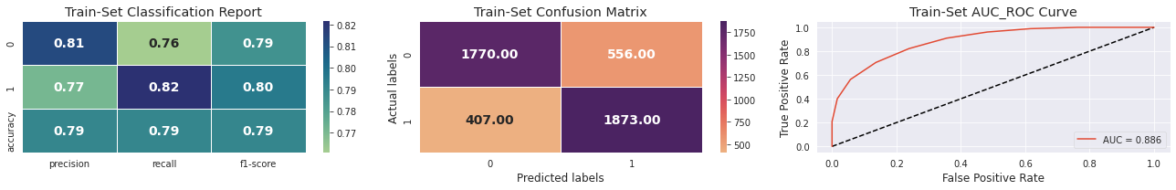

5. K-Nearest Neighbour(K-NN)

Slide 29
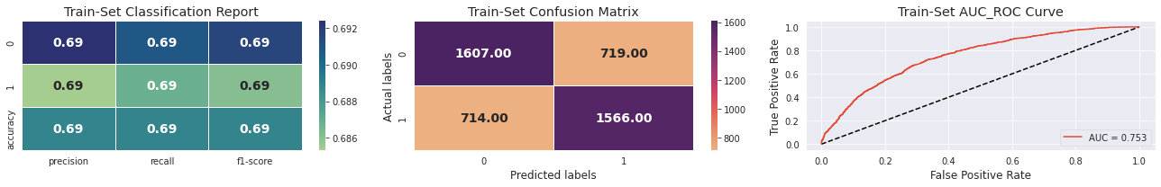

6. Support Vector Machine(SVM)

Slide 30
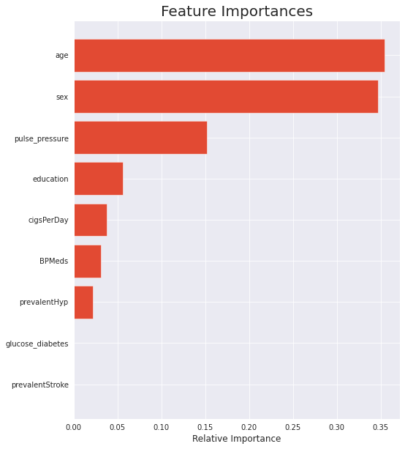
Feature Importance

Slide 31
Conclusion:
In the dataset, 56.7% of individuals are female and rest are male and males are more prone to CHD as compared to females.
50.24% of the individual present in the dataset are into smoking and residents who are consuming more cigarettes are at risk of getting suffered with Heart Diseases.
Only 2.9%, people are taking BP Medicines and BP patients are having high chances of CHD.
0.6% and 31.5 % people, have a history of strokes and hypertension
respectively.
2.6% people have diabetes who are more prone to CHD.
15.1% people have chance of getting heart disease in ten years.

Slide 32
Conclusion:
In the dataset most of the population have Education Level
1 with 42.1% and least education level 4 with 11.3%
With increasing age chances of having cardiovascular disease increases.
People above 65 years (i.e. old people) are more vulnerable to Heart Diseases.
SysBP and diaBP are positively correlated with each other.
Patients who are having stroke or hypertention history, diabetes more prone to CHD.
There are more males consuming cigarattes as compared to males.
Higher glucose level lead to heart diseases resulting higher chances of diabetic patients to cardiovascular disease.

Slide 33
Conclusion(Contd):
Results from ML models:
Implimented 6 classification ML ModelsLogistic Regression, Random forest, XGboost, Naive Bayes, KNN and SVM in our analysis.
Considered XGboost as our final optimal model as we are getting highest recall, precision, f1 score, accuracy and auc-roc from it.
Out of 1152 patients our optimal model is correcly predicting 457 of class 0 and 511 of class 1 patients, other 88 and 96 are FN and FP cases.
Age, sex and pulse pressure are the highest contributing features towards the predictions.
Best parameters of XGboost found out to be learning_rate: 0.1, max_depth: 5 and n_estimators: 350.
No overtfitting has been observed in any of the model.

